Slide 1
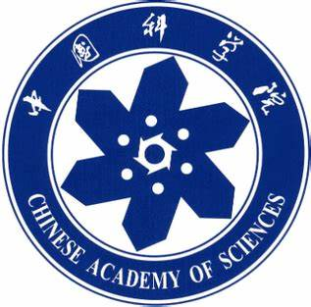
Chongqing University of Technology
ATAI
Advanced Technique of Artificial Intelligence
Chongqing University of Technology
A Graph-based Relevance Matching Model for Ad-hoc Retrieval（AAAI_2021）
Yufeng Zhang, Jinghao Zhang, Zeyu Cui, Shu Wu and Liang Wang
Institute of Automation, Chinese Academy of Sciences
University of Chinese Academy of Sciences
Artificial Intelligence Research, Chinese Academy of Sciences
{yufeng.zhang,jinghao.zhang}@cripac.ia.ac.cn
{zeyu.cui,shu.wu,wangliang}@nlpr.ia.ac.cn
2021.9.14 • ChongQing
Reported by Lele Duan
Code:https://github.com/CRIPAC-DIG/GRMM

Slide 2
Chongqing University of Technology
ATAI
Advanced Technique of Artificial Intelligence
Chongqing University of Technology
1.Background
2.Method
3.Experiments

Slide 3
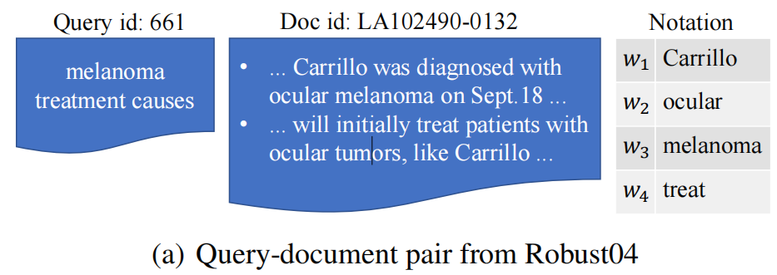
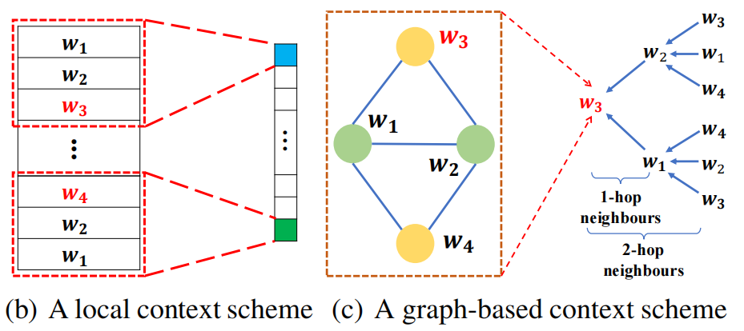
Background
Task : Given a query, finding the most relevant document.
Recent deep learning models regard the task as a term-level matching problem, which seeks exact or similar query patterns in the document.
Local interactions
Do not generalise to ubiquitous, non-consecutive contextual relationships.

Slide 4
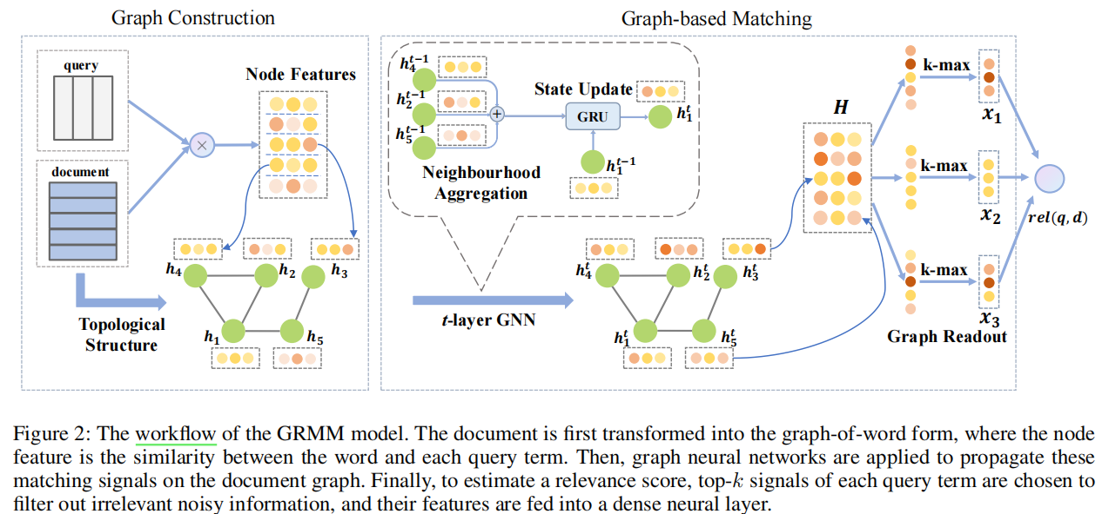
Method
Over view

Slide 5
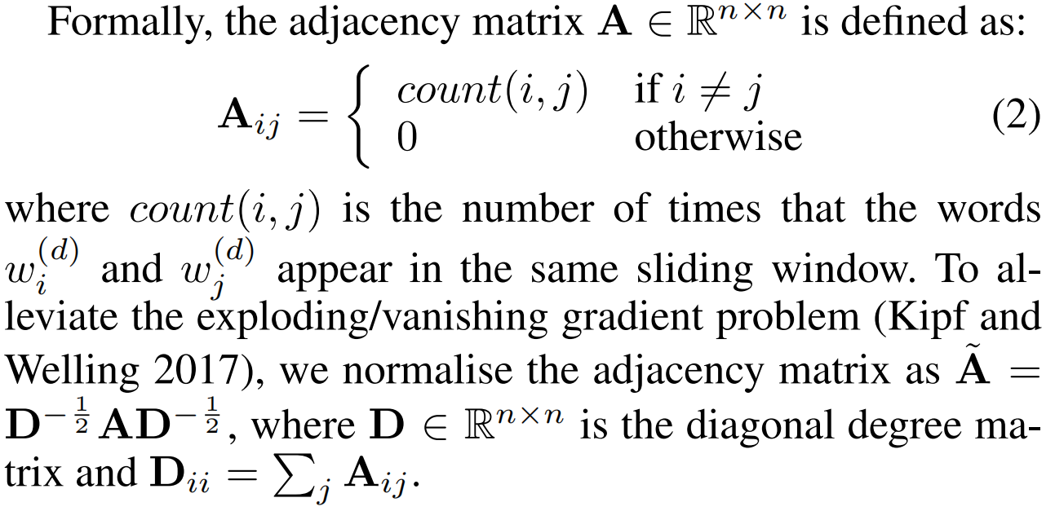
Method
Graph Construction
Node features:
Topological structure:

Slide 6
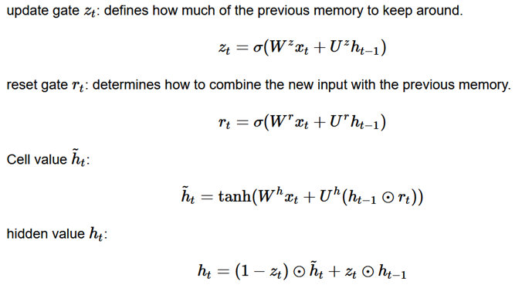
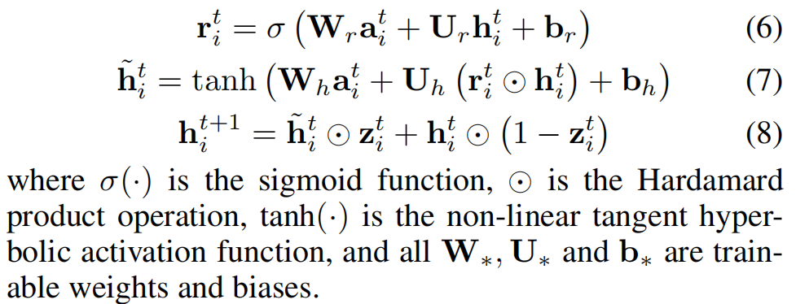
Method
Graph-based Matching：
Neighbourhood Aggregation:
State Update:

Slide 7
Method
Matching Score and Training：
Graph Readout:

Slide 8
Experiment

Slide 9
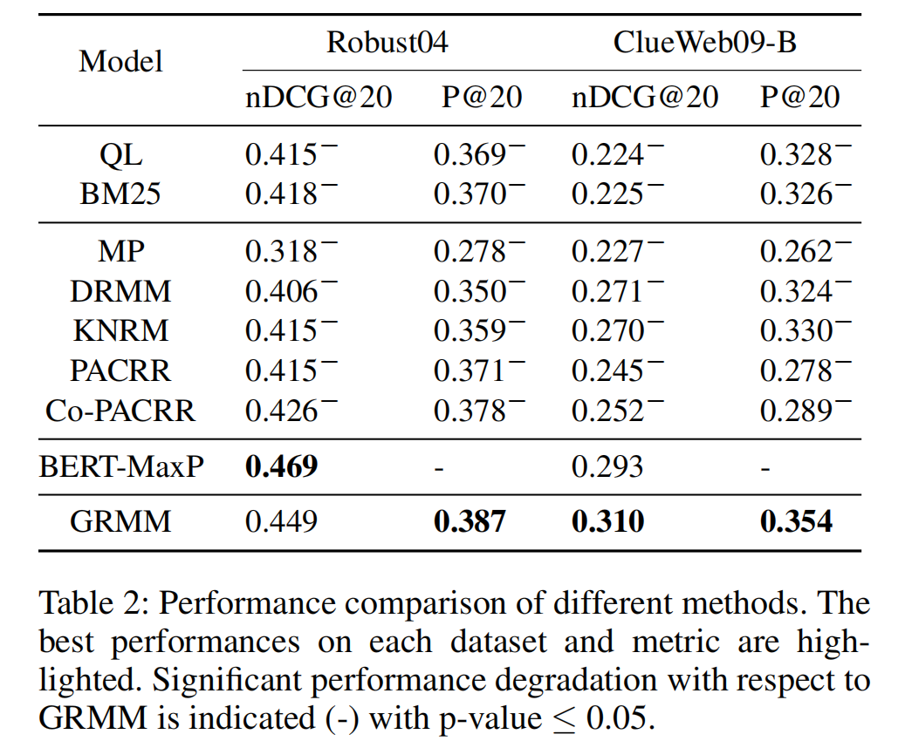
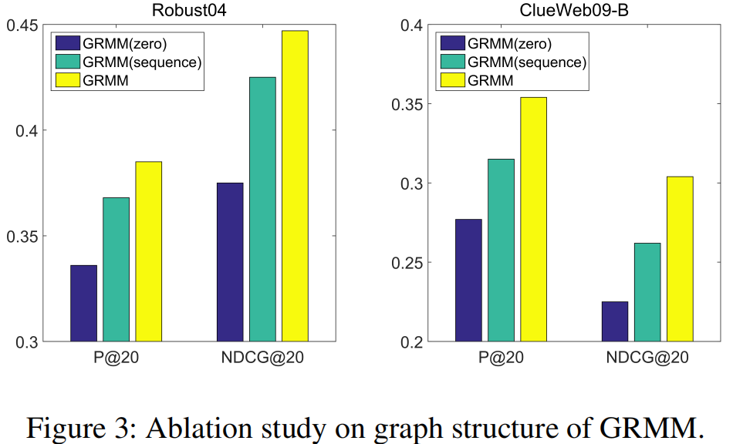
Experiment

Slide 10
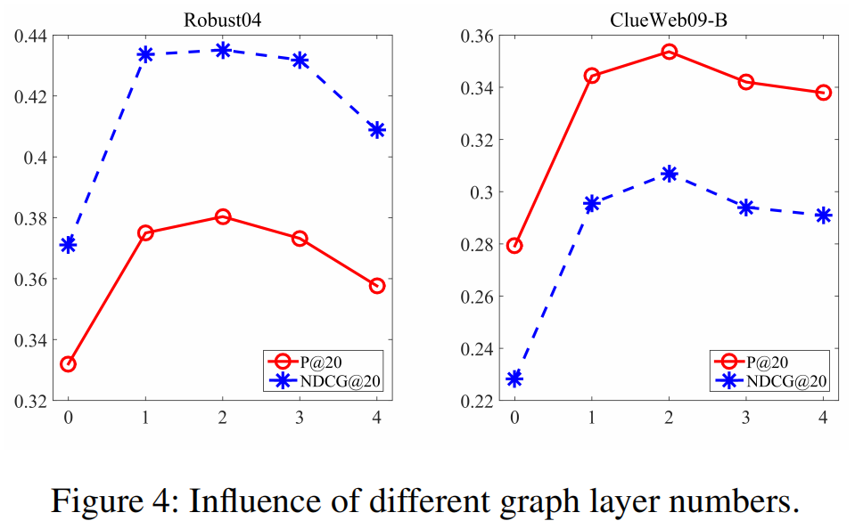
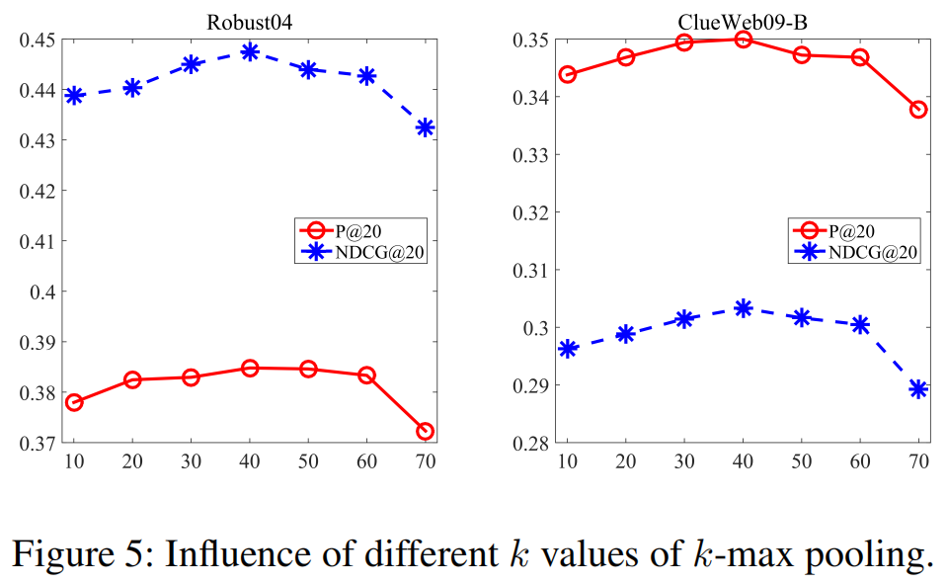
Experiment

Slide 11
Chongqing University of Technology
ATAI
Advanced Technique of Artificial Intelligence
Chongqing University of Technology
Thank you!

